Slide 1

SaveMate: Your Personal AI Finance Manager
Track, Analyze, and Save – Smarter with AI

Slide 2



The Unseen Struggle: Why Personal Finance is Hard
Expense Overload
Manual Entry Pain
Current Tools Fall Short
Most individuals struggle to consistently track their daily expenses, leading to a lack of financial clarity and control.
Traditional methods are time-consuming, prone to human error, and often abandoned due to their tedious nature.
Existing voice-to-text solutions lack automation, intelligent categorisation, and are primarily limited to English speakers, excluding a vast global audience.

Slide 3
Introducing SaveMate: The AI-Powered Solution
Voice-to-Text Expense Logging
AI Bill & Receipt Reader
Smart Categorisation
Scan any bill (electricity, hotel, shopping), and our AI automatically extracts and categorises details.
Expenses are intelligently classified into categories like Food, Utilities, and Travel, providing clear financial insights.
Simply speak your expenses, and SaveMate logs them instantly, making tracking effortless.
Multilingual Support
Personal AI Financial Agent
Track your finances in multiple Indian languages, breaking down language barriers for diverse users.
Get instant answers to your financial questions, analyse spending patterns, and receive personalised advice 24/7.

Slide 4

SaveMate's Edge: Unmatched Uniqueness
Multimodal Inputs: Seamlessly integrate voice, image, PDF, and manual entries for comprehensive tracking.
AI-Powered Receipt Processing: Our unique AI directly reads bills and updates expenses, eliminating manual data entry.
Personalised & Actionable Insights: Receive custom monthly reports, budget alerts, and spending trend analyses.
Expansive Multilingual Access: Beyond English, SaveMate supports Hindi, Telugu, and other regional languages, ensuring true accessibility and inclusivity for users across India.

Slide 5
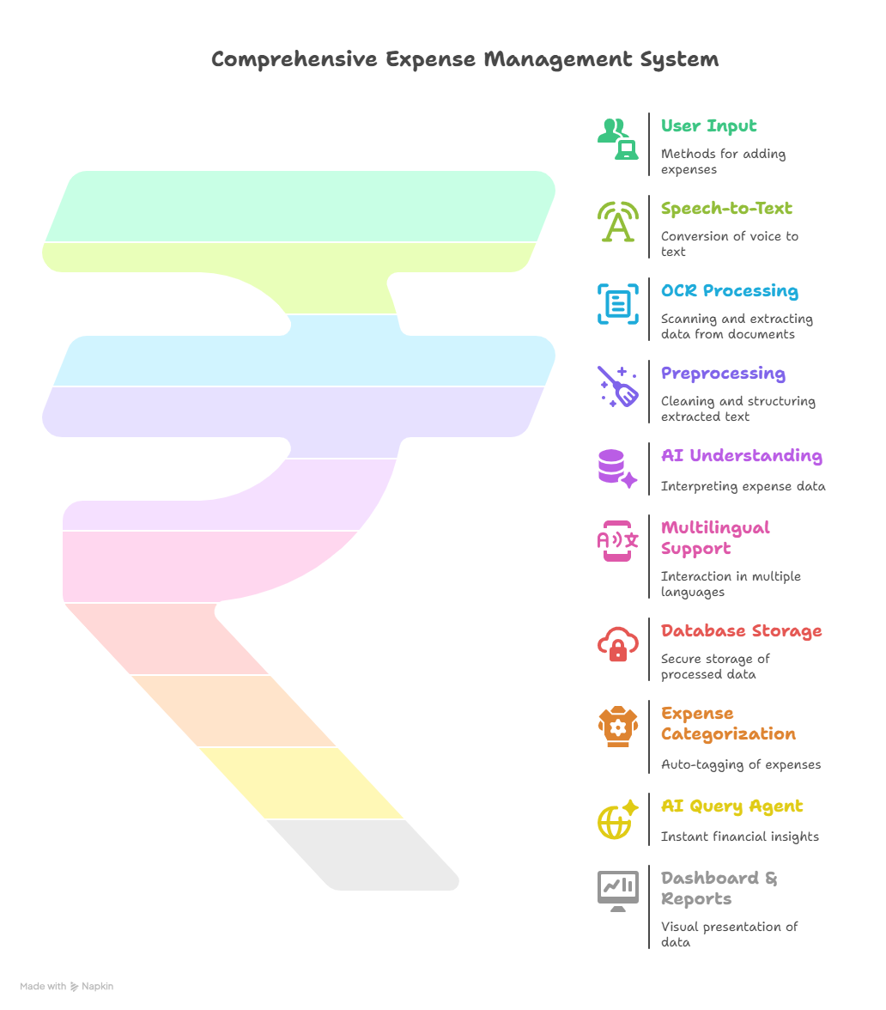

Slide 6
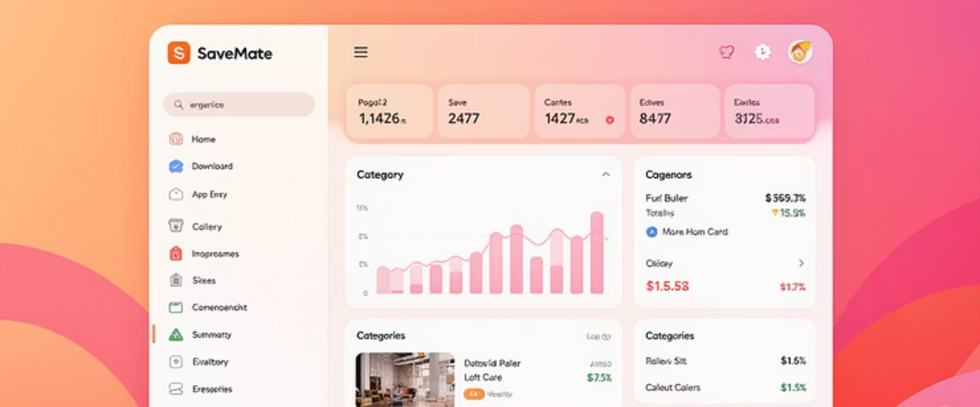



SaveMate in Action: Key Features

Slide 7
Transformative Benefits for Every User
Save Time & Effort
Smart Financial Insights
Automates tedious tracking, freeing up users' valuable time.
Provides actionable data for informed financial decisions.
Truly Universal Accessibility
Foster Better Financial Habits
Multilingual support ensures SaveMate works for everyone, everywhere.
Encourages mindful spending, planning, and long-term savings.

Slide 8
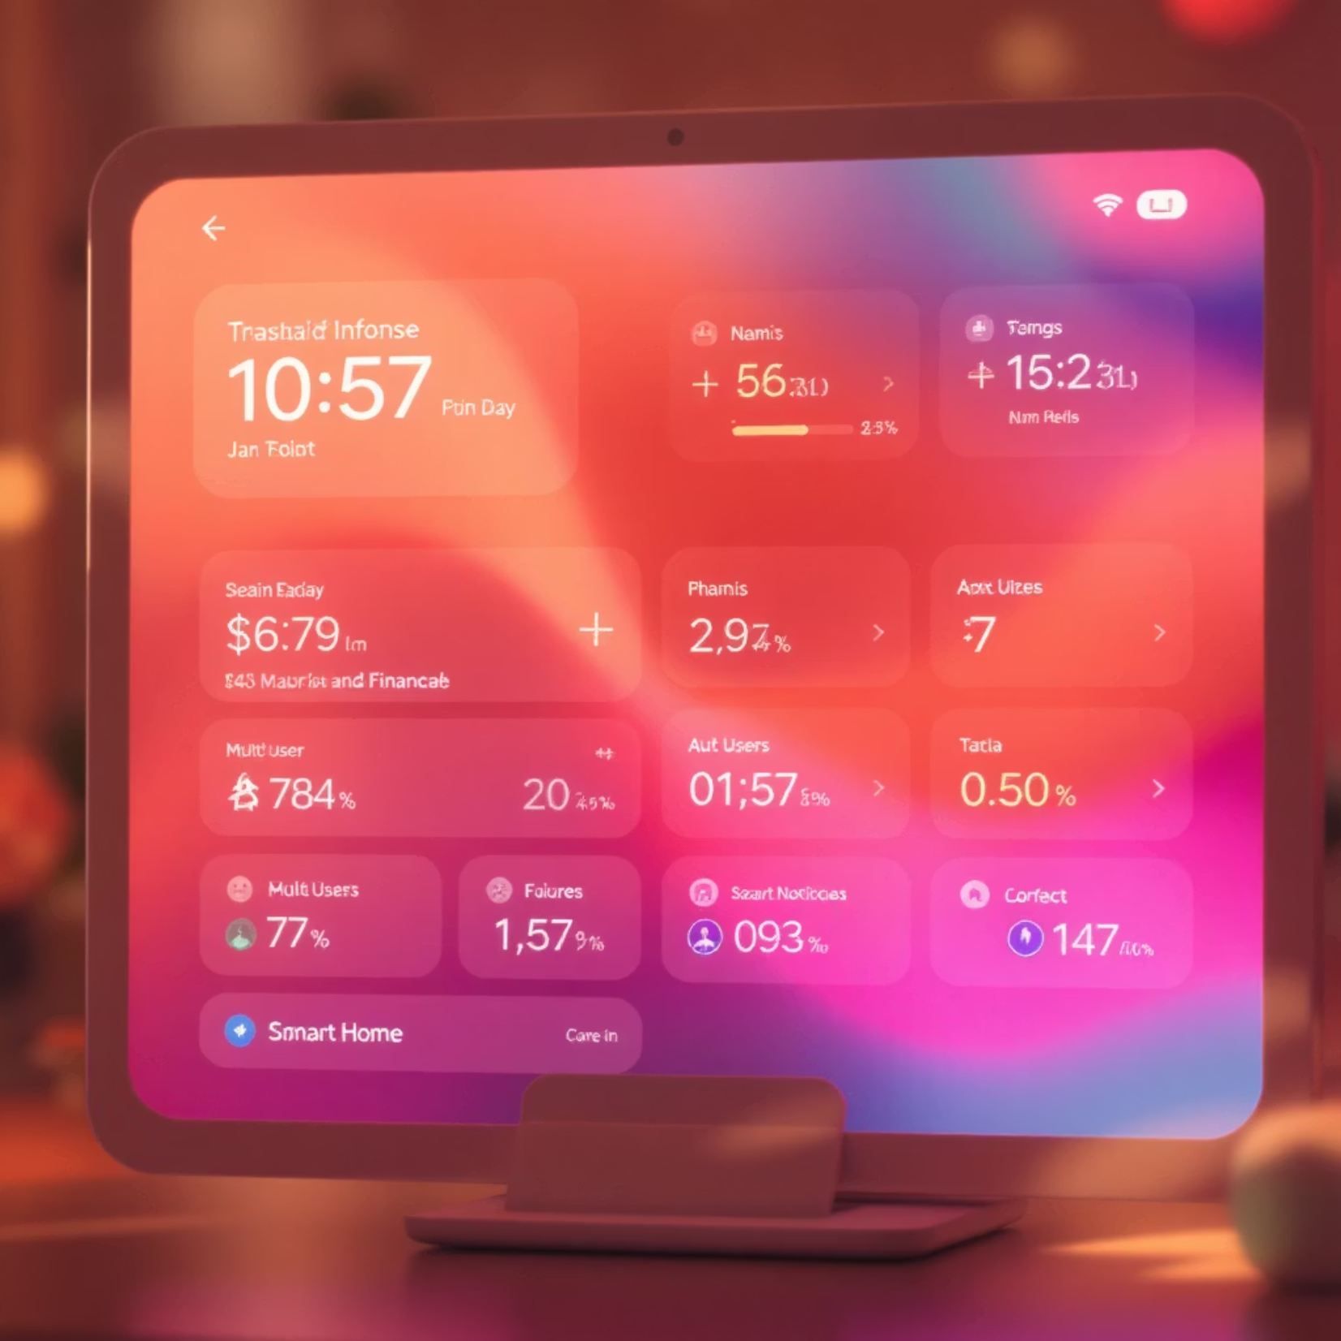
Future Horizons: Expanding SaveMate's Reach
Multi-User Family/Group Tracking: Enable collaborative finance management for households or small teams.
Smart Notifications: Proactive alerts for bill due dates, subscription renewals, and unusual spending patterns.
Seamless UPI/Bank Account Integration: Direct sync with financial institutions for real-time transaction updates.
Advanced Predictive Analysis: AI-driven forecasts, e.g., "You may overspend this month based on current trends," with actionable advice.
Personalised Financial Goal Setting: Assist users in setting and achieving savings goals with tailored guidance.

Slide 9
Conclusion: SaveMate – Finance Made Simple, Smart & Accessible
AI-Powered
Inclusive
Leveraging cutting-edge AI for intelligent automation and insights.
Designed for everyone, with multilingual support and user-friendly interface.
User-Friendly
Future-Ready
Intuitive design for effortless expense tracking and financial management.
Built on a scalable tech stack with a clear roadmap for continuous innovation.

